Slide 1

Hammerhead Tron AI
Alex Laurent, Nick Bolles, David Dowling, John Scott

Slide 2
Outline
Motivation
Problem
Approach
Implementation and Initiation breakdown
Evaluation
Conclusion

Slide 3
Motivation
Understanding gaming AI
Explore all of the possibilities of Tron AI approaches

Slide 4
Problem
Making a Tron AI is surprisingly difficult
There are few calculable ways to win the game
Outcomes are difficult to assign any kind of scoring system to

Slide 5
Approach
AI must first be defensive
Focus on human error
2 attack types (boxing and cutting off)

Slide 6
Implementation
Using a modified version of Tronament
Tron game that allows for AI Module plugins.
AI built in JavaScript
Navigated with modified A* search
Master AI to control decision-making based on heuristics from states
3 states
Chase: tracks down player and mimics movements, wait for an opportunity to cut off the player
Bail: breaks away from player and moves to least occupied space
Attack:
Box in: draws a box around the player, trapping them
Cut-off: cuts the player off before they can react

Slide 7
Overall Structure
A* Nav
Master AI
Distance Based Initiation
Distance Based Initiation
Chase Agent
Bail Agent
Box In
Cut Off
Reaction Based Initiation

Slide 8
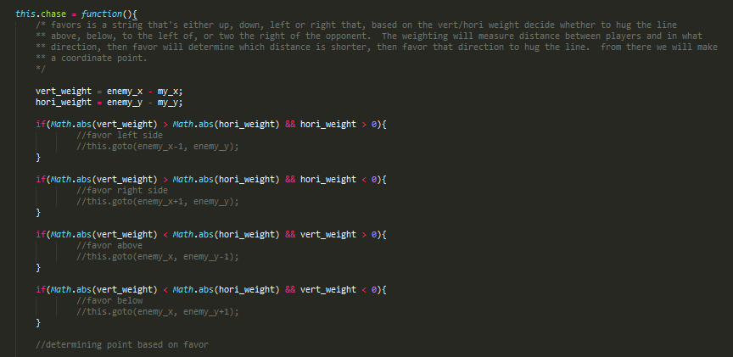
Example of chase state

Slide 9
Reaction Based Initiation

Slide 10
Reaction Based Initiation 2

Slide 11
Reaction Based Initiation 2
2
1
1
0
0
0

Slide 12
Evaluation
When building a Tron AI remember to:
Stick to one concept
Make the AI expandable
Design with the aspects of Tron in mind

Slide 13
Conclusion
Building a Tron AI is harder than expected
A proper navigation technique is a must have
When playing Tron, distance from player is key

